Slide 1
Predicting Stock prices with LLM and LSTM

Slide 2

I've finally found it after running 30 hours of coding and epochs

Slide 3


Introduction and objective
The primary goal of this project is to conduct sentiment analysis on financial news data and subsequently employ this sentiment data, along with historical stock prices of TSLA, to construct and assess LSTM models for predicting higher stock prices.
Through this project, we intend to gain a better understanding of how sentiment relates to stock price changes and evaluate the models' predictive performance.
Notes:
The main objective of this project is to perform sentiment analysis on financial news data and use that sentiment data, along with historical stock prices of tesla, to build and evaluate LSTM models for predicting high stock prices. The code aims to provide insights into the relationship between sentiment and stock price movements while also assessing the predictive accuracy of the models.

Slide 4
PROBLEM SOLVING
Evaluation
Identify
Evaluate the solution
Identify the problem
application BUILDING
Problem
Solving
cycle
DATA COLLECTION
A web application to be designed
Data collection from different sources
Model building
Data Pre-processing
Different steps involved in Model Building
Data pre-processing techniques to convert data into a format suitable for input to the model

Slide 5
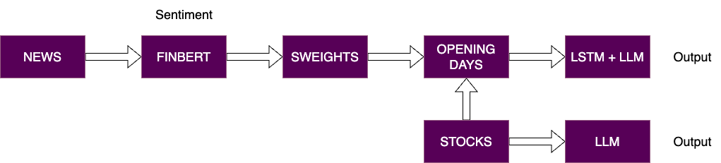
architecture

Slide 6
data
1. Financial News Sentiment Data:
The data originates from the AlphaVantage API and pertains to news articles associated with the stock symbol "TSLA" (representing Tesla).
Sentiment analysis is conducted on the news article summaries using a pre-existing model called "finbert" to categorize the sentiment of each article into one of three categories: "Negative," "Neutral," or "Positive.”
2. Historical Stock Price Data:
This data is obtained from Yahoo Finance through the utilization of the "yfinance" library, and it pertains to the stock symbol "TSLA".
Key components of the historical stock price data include open, high, low close prices, timestamps.

Slide 7
LSTM Stock prediction model overview
LSTM Networks: Highly effective in capturing long-term dependencies and trends in time-series data, making them ideal for forecasting complex patterns in stock market movements.
Rolling Window Approach: Utilizing a window size of 101 to capture temporal dependencies in stock data.
Model Architecture:
Multiple LSTM layers with varying units (e.g., 100, 512, 256, 128) for deep learning.
A final Dense layer for output prediction.
Training Parameters:
Loss Function: Mean Squared Error (MSE).
Optimizer: Adam.
Epochs and Batch Size: 10 epochs, 64 batch size for training efficiency.
Model Training:
Validation on test data during training for performance monitoring.
Shuffle enabled to ensure model generalization.

Slide 8
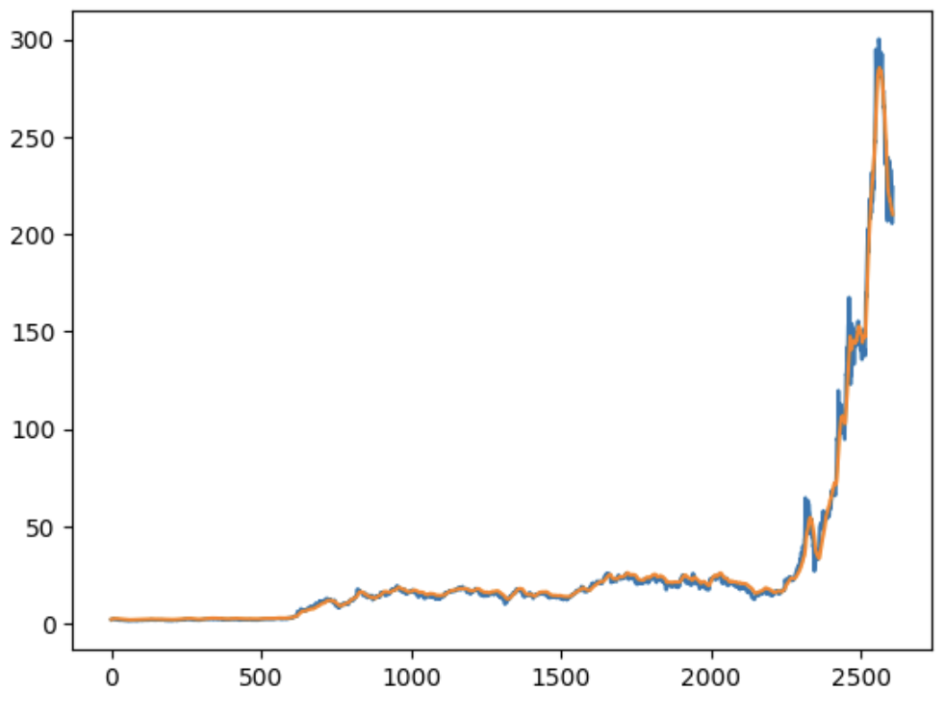
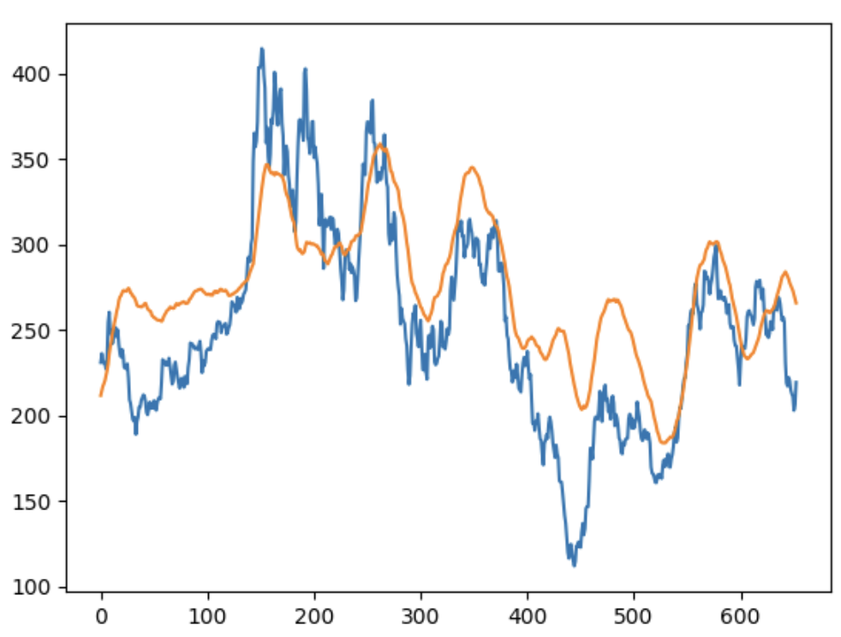
LSTM Predictions
LSTM Stock High price on Training Data
LSTM Stock High price on Testing Data

Slide 9
Sentiment Analysis with FinBERT
Model & Tokenizer: Utilizes ProsusAI/finbert, a BERT model pre-trained on financial texts, coupled with BertTokenizer for efficient text processing.
Sentiment Prediction Function:
Tokenizes input text and prepares it for the model.
Employs the model to predict sentiment class (Negative, Neutral, Positive) based on the logits.
Data Application:
Demonstrated on the new dataset which we collected from AlphaVantage.
Provides insights into sentiment trends within financial texts.

Slide 10
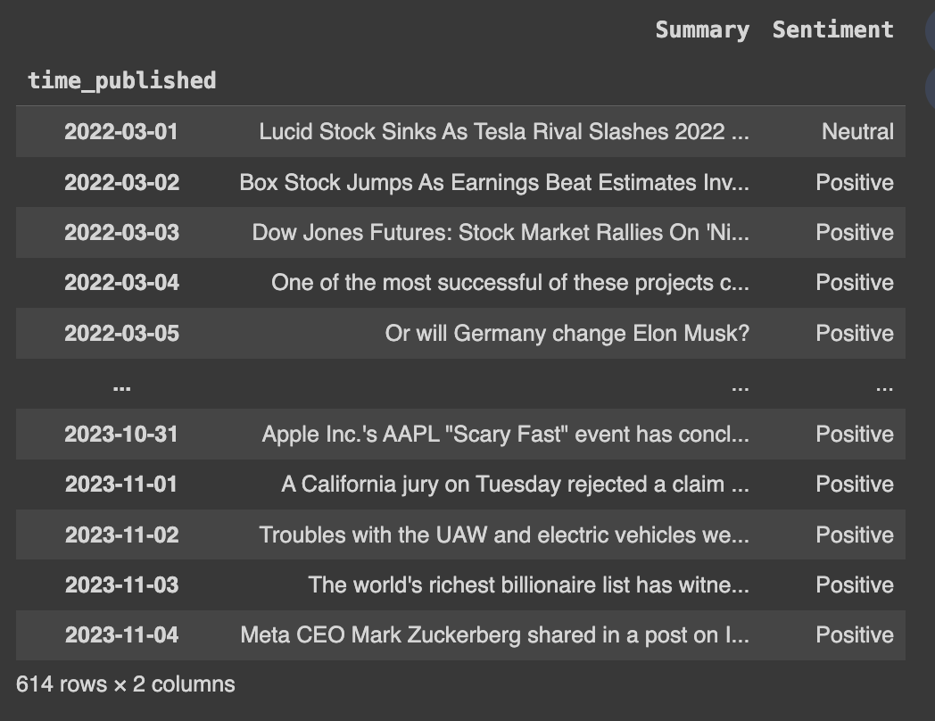
Sample Data With FINBERT sentiments

Slide 11
LSTM Stock Price Prediction with LLM Sentiments
Integration of LSTM with LLM Sentiments: Enhances stock price prediction accuracy by incorporating nuanced sentiment analysis from Language Models (LLM) into the LSTM's time-series forecasting, capturing the impact of market sentiment on stock movements.
Data Integration: Combines stock prices with sentiment analysis (Neutral, Positive, Negative) derived from LLM (like FinBERT).
Data Processing:
One-hot encoding of sentiment labels.
Standardization of 'High' stock prices using StandardScaler.
Feature Preparation:
Sequence creation for LSTM input, incorporating sentiment and price data.
Sequence Length: 2 (for capturing temporal dependencies).
LSTM Model Architecture:
First Layer: 128 LSTM units with return sequences.
Second Layer: 256 LSTM units without return sequences.
Output Layer: Dense layer with a single unit.
Optimization: Adam optimizer with Mean Squared Error loss.

Slide 12
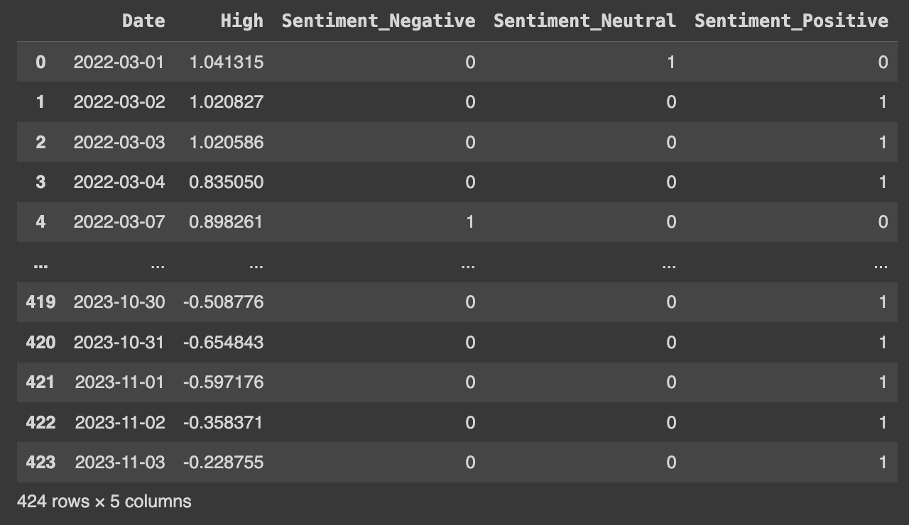
LSTM Stock Price Prediction with LLM Sentiments. (CONT)
Training and Testing:
80% training and 20% testing split.
Model trained for 100 epochs with a batch size of 32.
Results Visualization:
Plot comparing actual vs. predicted 'High' stock prices.
Demonstrates the model's efficacy in forecasting stock prices influenced by sentiment trends.

Slide 13
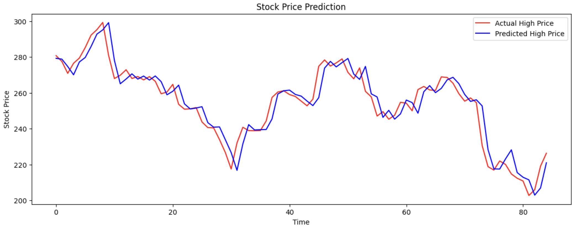
LSTM Stock Price Prediction with LLM Sentiments

Slide 14
Lstm v/s lstm wITH llm
LSTM
LSTM with LLM

Slide 15
Future SCOPE
Enhance LSTM Model: Experiment with various architectures and hyperparameters.
Expand Sentiment Sources: Include news and social media for richer sentiment analysis.
Incorporate Additional Financial Indicators: Utilize more market data like volume, open/close prices.
Real-Time Prediction System: Develop a system for live market data analysis.
Widen Market Coverage: Apply the model to diverse stocks, bonds, or cryptocurrencies.
Advanced NLP Techniques: Leverage newer language models for deeper sentiment insights.
Model Explainability: Implement tools to understand model decision-making processes.
User-Friendly Platform: Develop an application for accessible real-time market predictions.

Slide 16

tHANK you

